Slide 1
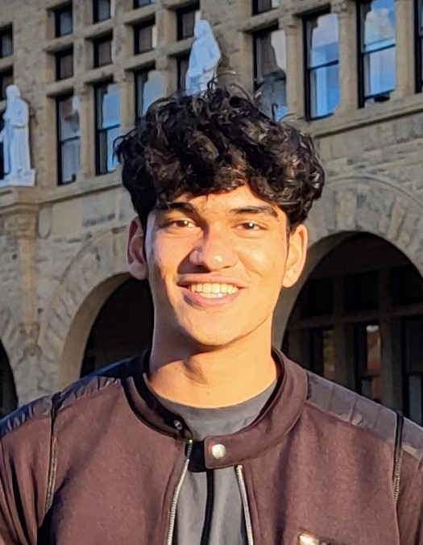
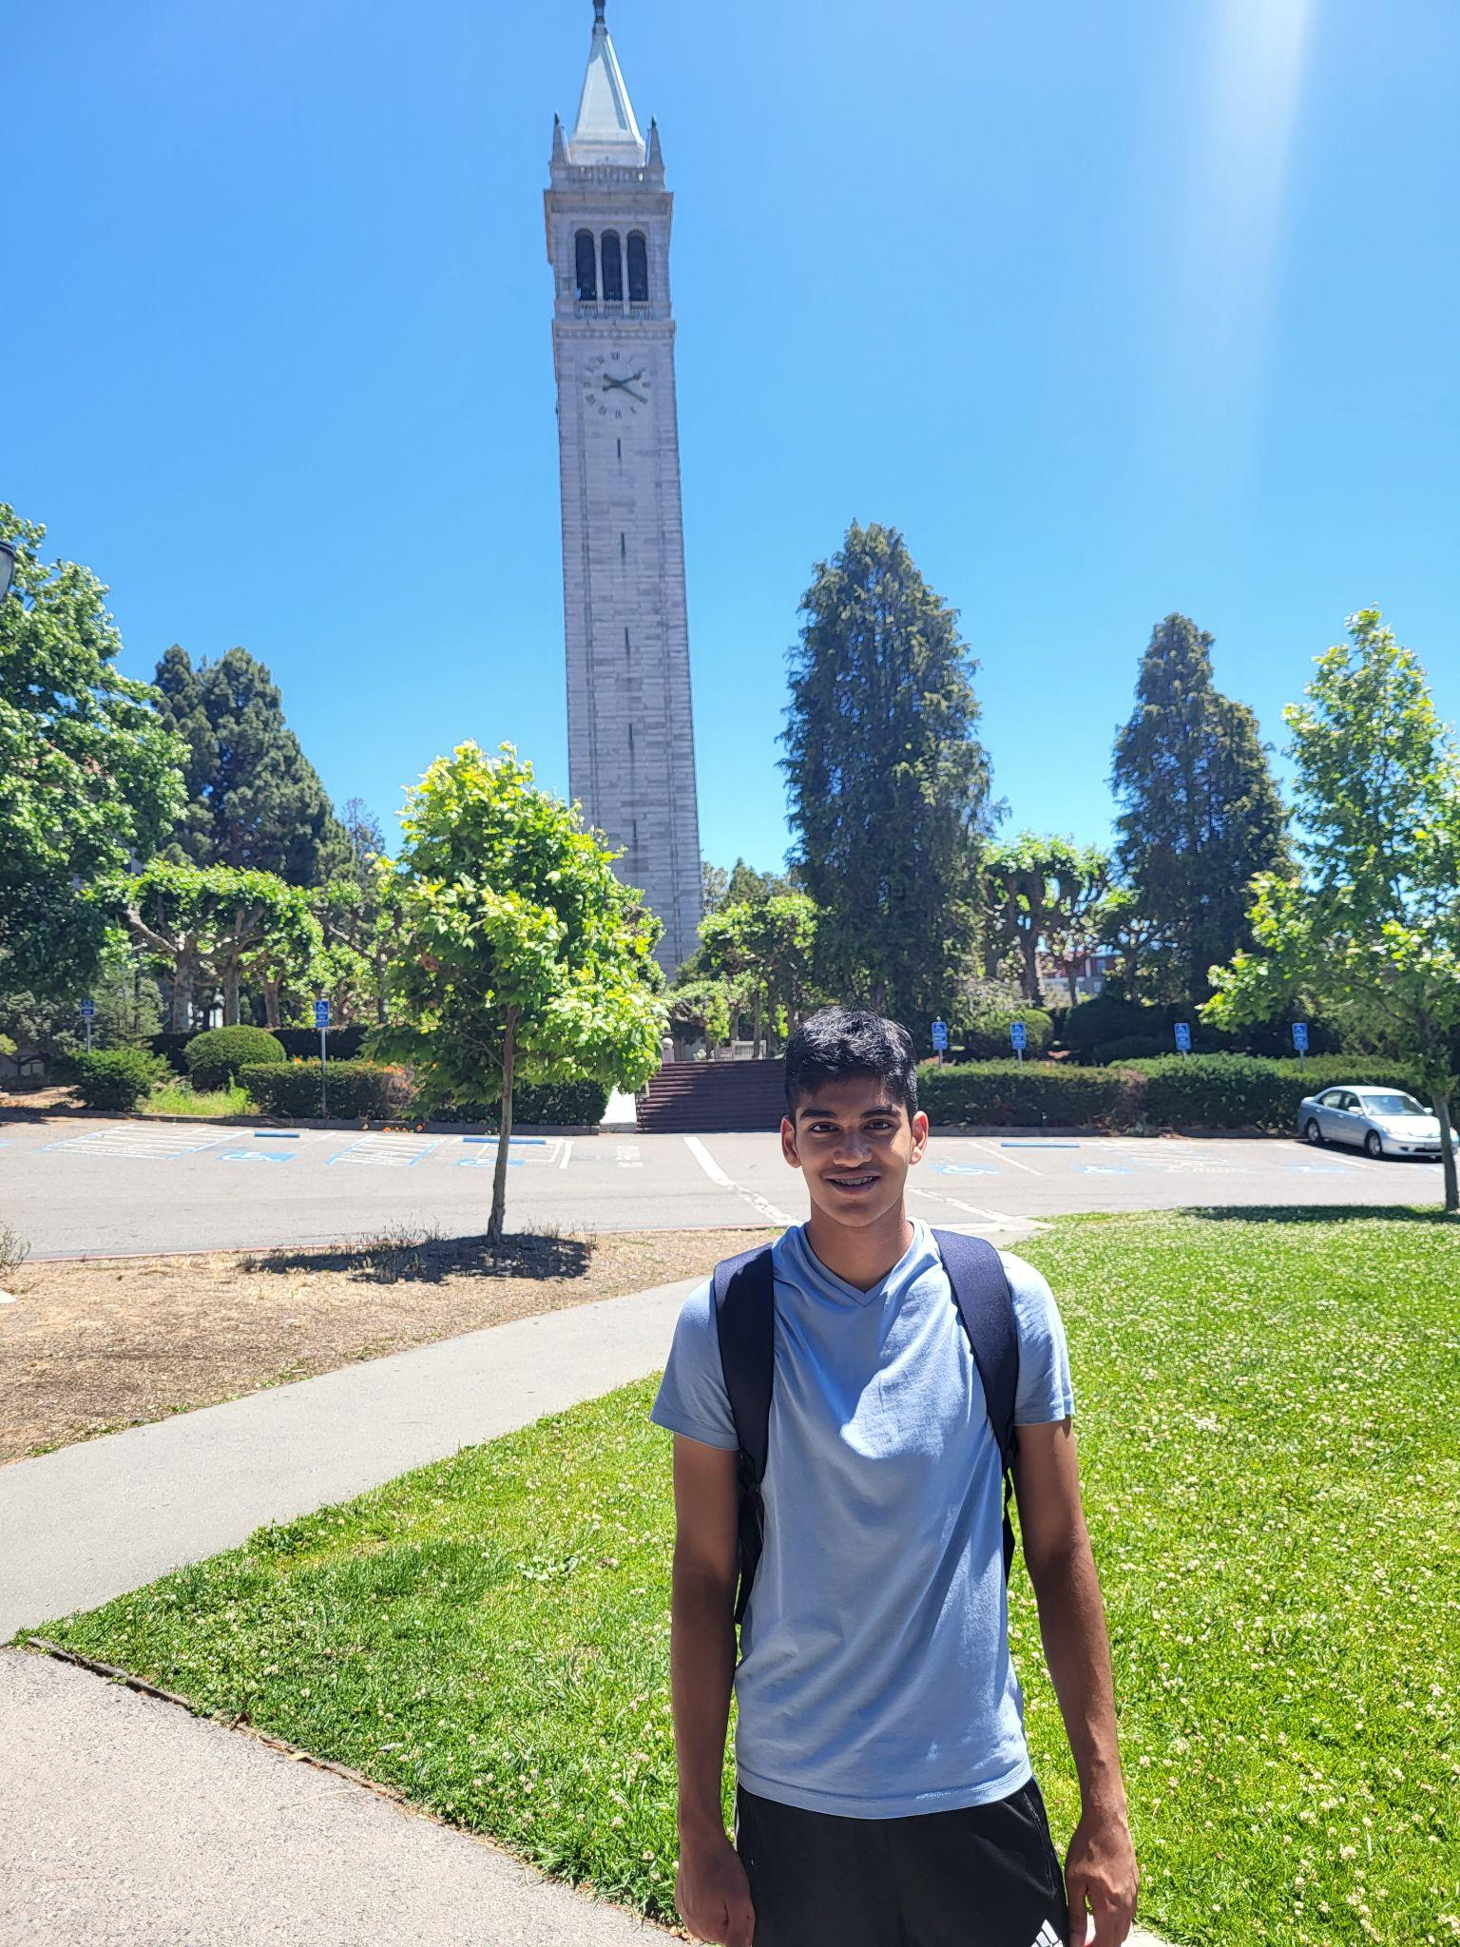
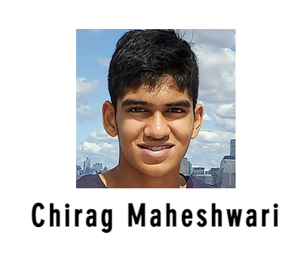
Introduction
I just graduated high school last Wednesday!
I have been interning at the Aiden Lab since 9th grade
I am really interested in math and computer science, especially machine learning.

Slide 2
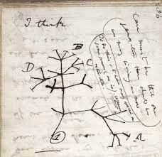
Phylogenetic trees
Phylogenetic trees are family trees between different species of animals. They tell us the path evolution took by showing how closely or distantly different species are related.

Slide 3
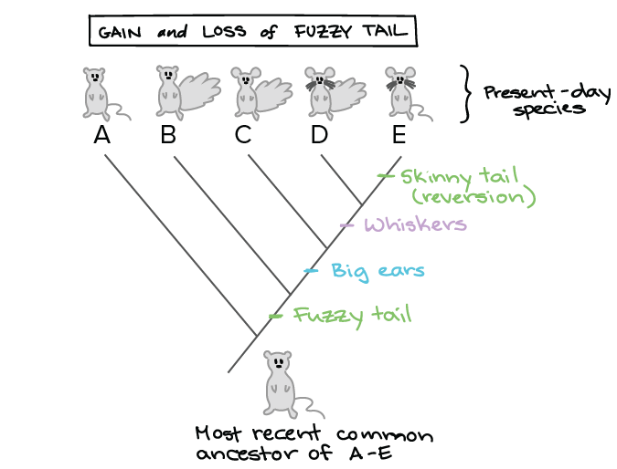
Basics: Phylogenetic characters
Any feature of a species that is common in other similar species can serve as a phylogenetic character.

Slide 4
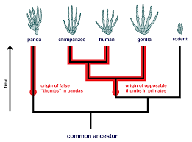
This is how species trees were built
Morphology looks at the form and structure of an organism to reconstruct phylogenies. However, this form of reconstruction is not very accurate.

Slide 5
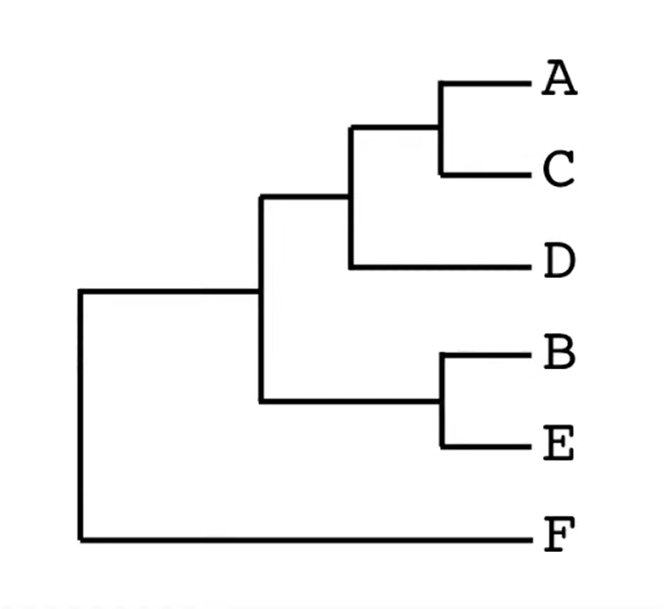
This is how species trees are often built now
A ATCGTGGTACTGT
B CCGGAGAACTAGT
C AACGTGCTACTGA
D ATGGTGAAAGTGT
E CCGGAAAACTTGT
F TGGCCCTGTATCA
Phylogenies can also be reconstructed through the large number of DNA Bases in an organism’s genome.
However, there are only four possible mutations for a DNA Base. So, the species’ close and distant family cannot be accurately determined.
C
T
G
Notes:
Under the assumption that the mutation is random - Done
Highlight sequence of relevance - Done
Show some base which is accidentally the same - Done
Same for A, D, B, E different in C, F - Done

Slide 6
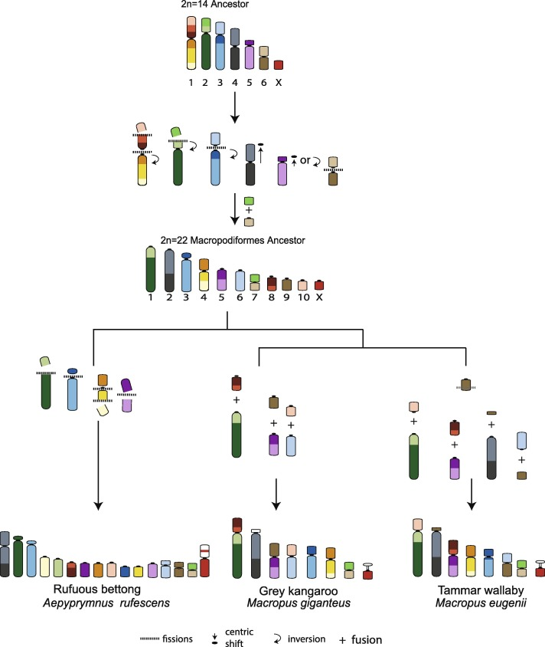
Here’s how we propose to build species trees
Chromosomes break and fuse from species to species
These events are rare and make (almost) perfect phylogenetic characters
Notes:
Much larger variation space than DNA Bases - Done
Some areas might be more prone to breaking than others - Done
Under the assumption that the break is random - Done
Less text - Done
¼ vs ⅓ billion - Done
Break into two slides - Use rearrangements as phylogenetic characters
Good visual language to represent data

Slide 7
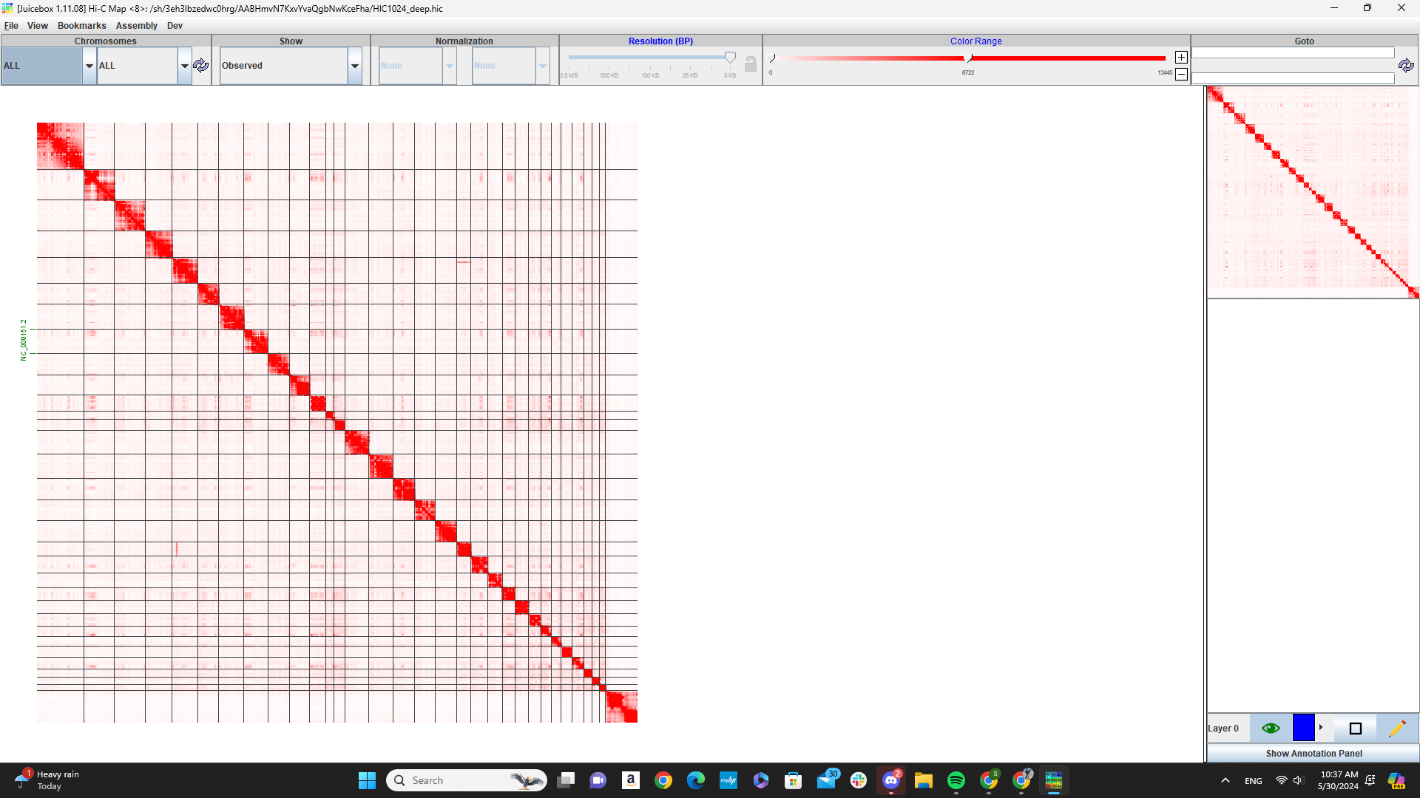
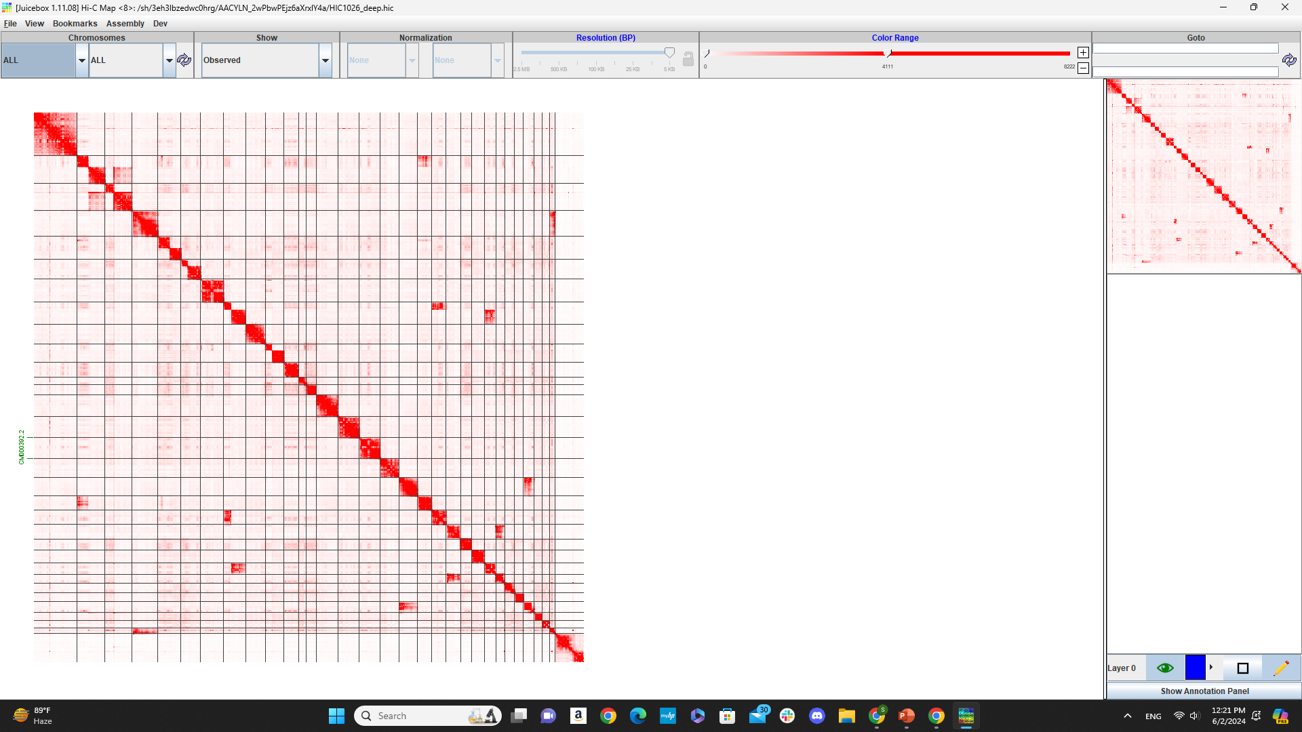
What do chromosomal rearrangements
look like with Hi-C
Horse Genome
Donkey Genome aligned to Horse
Notes:
Show typical characters

Slide 8
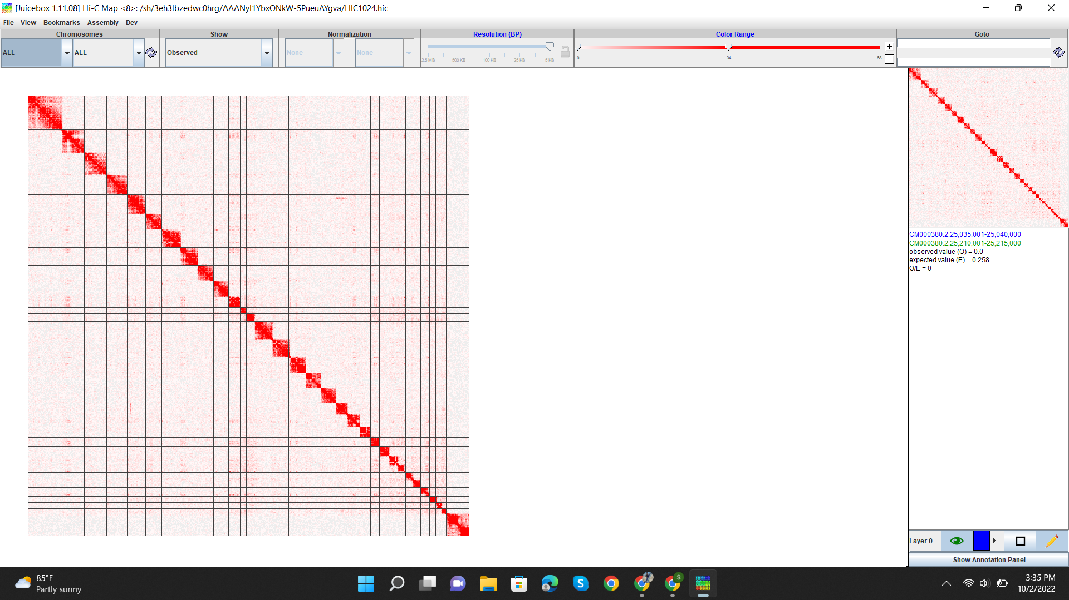
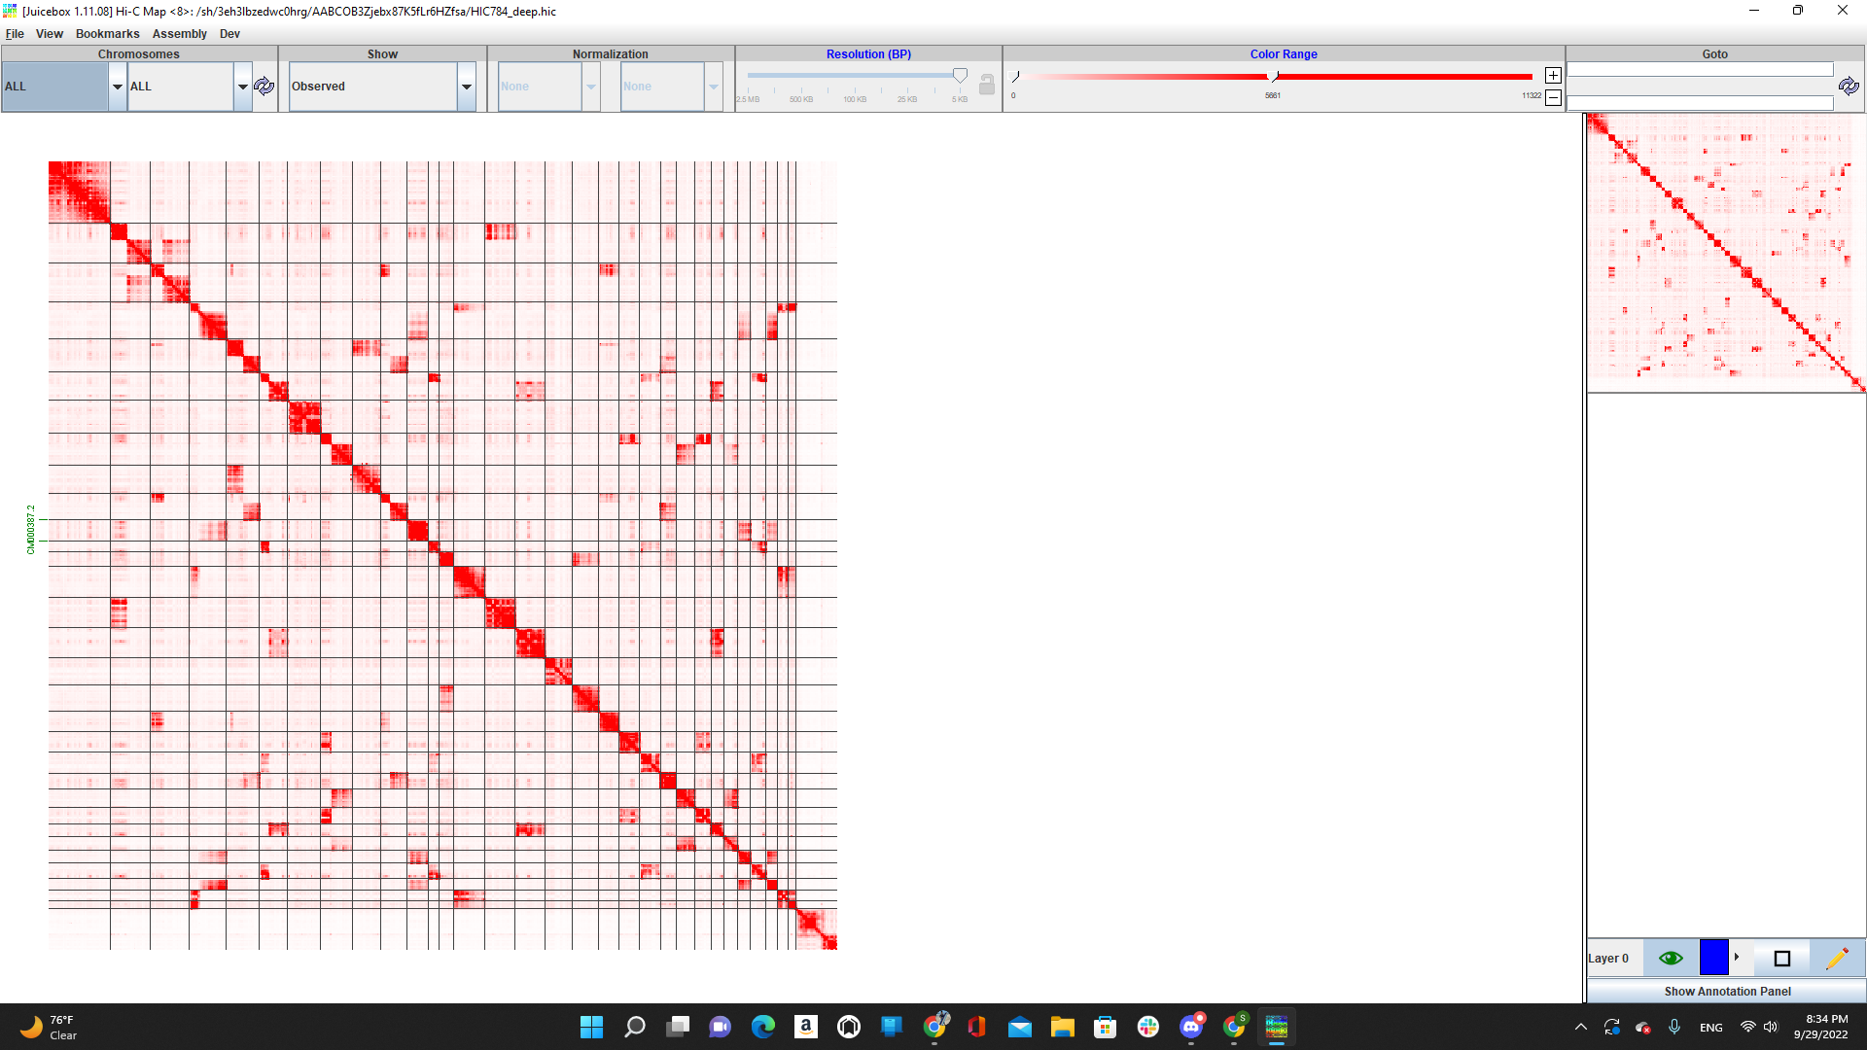
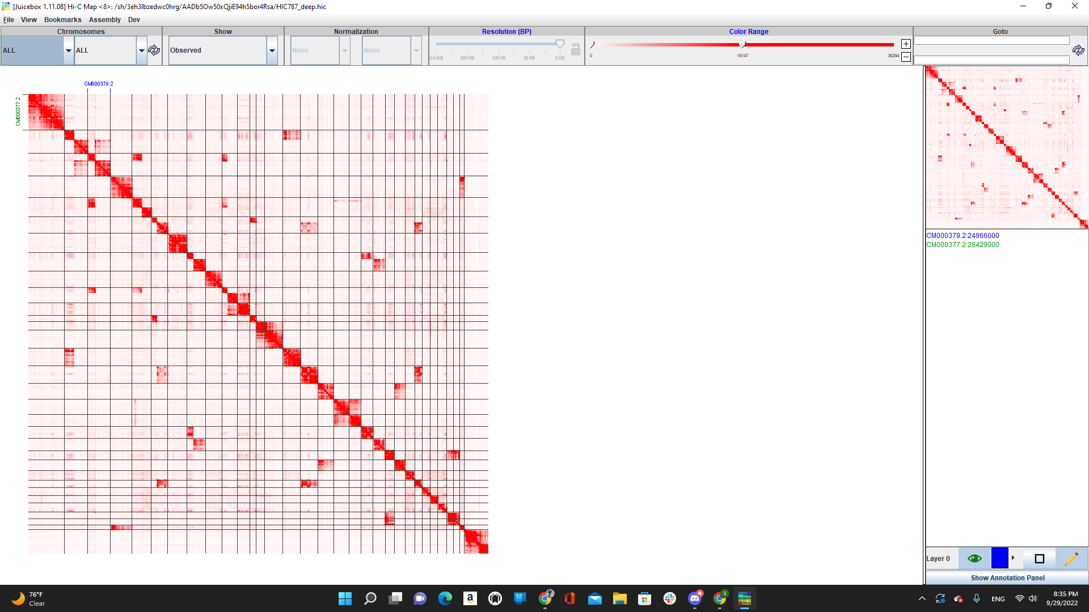
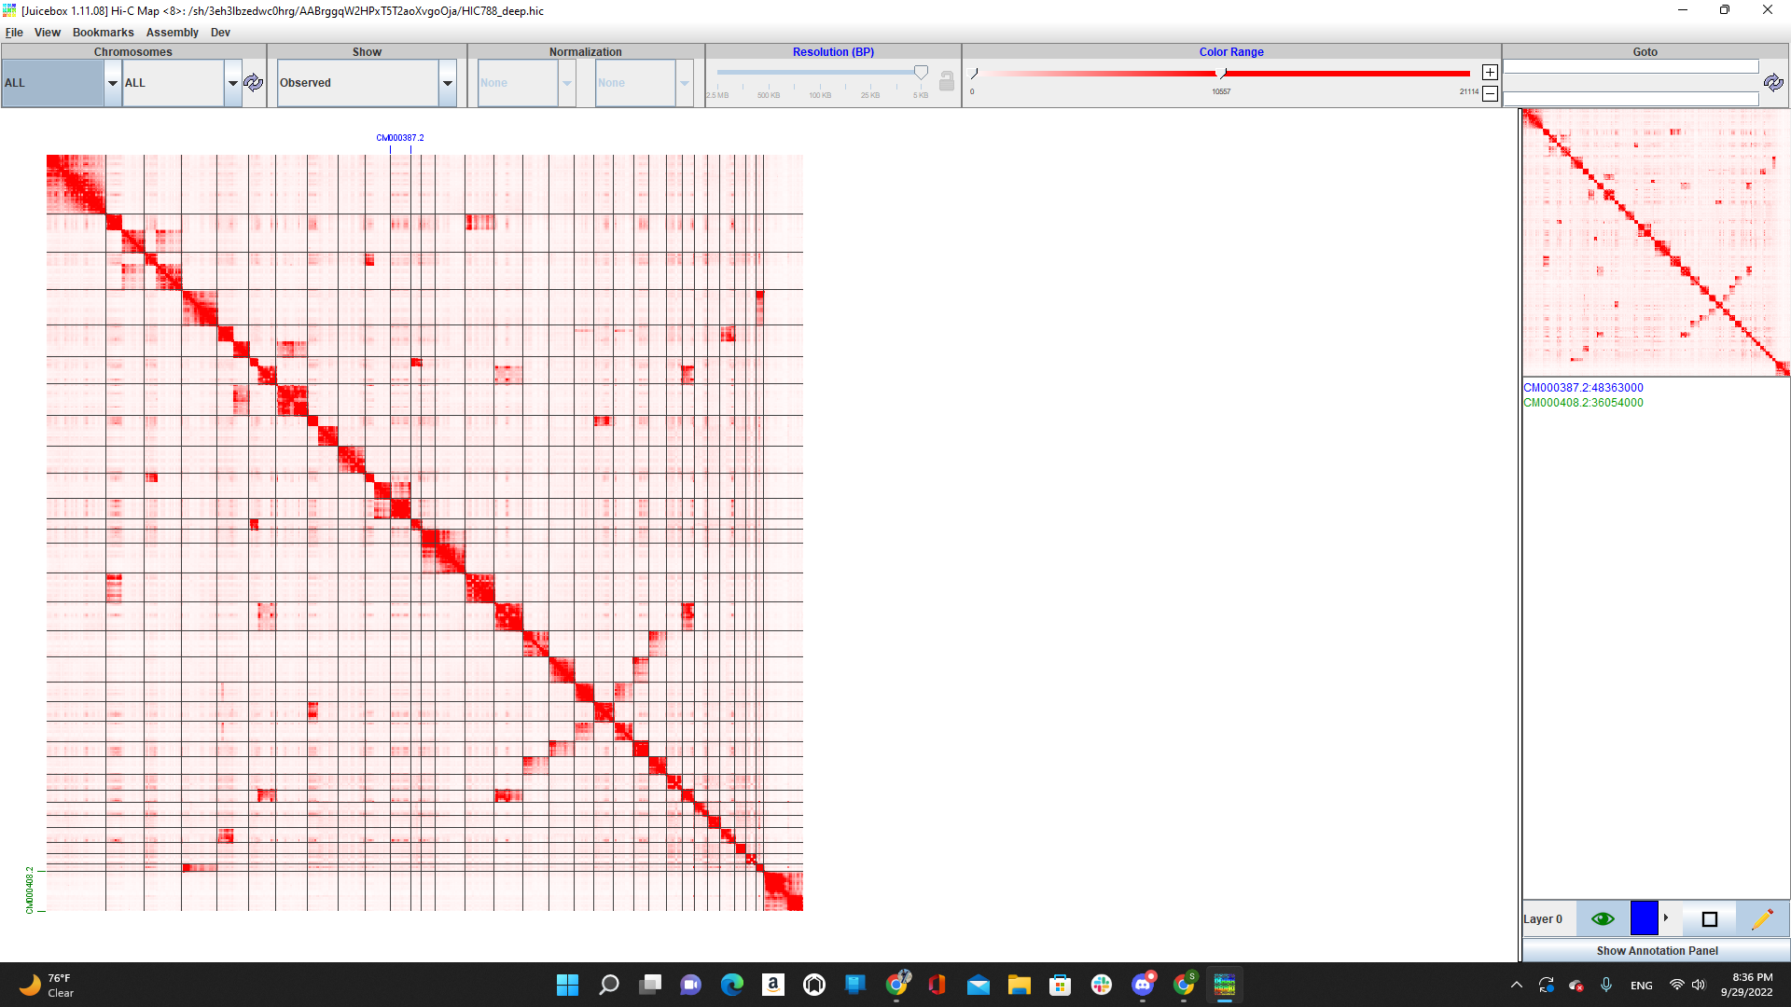
Let’s see if you can figure it out!
Mountain Zebra Zakota
Grant’s Zebra Zena
Grevy’s Zebra Zoatira
Horse

Slide 9
So, how do we automate this?
Detect Breaks
Detect Fusions
Build a character matrix and reconstruct phylogeny
Notes:
Transition slide to ML (no text) - Done
Abstract figure to represent ML - Done
ML is a blackbox - Done
Statistical analysis tool - Done
Computer vision
Look for better image

Slide 10
So, how do we automate this?
Detect Breaks
Detect Fusions
Build a character matrix and reconstruct phylogeny
Notes:
Transition slide to ML (no text) - Done
Abstract figure to represent ML - Done
ML is a blackbox - Done
Statistical analysis tool - Done
Computer vision
Look for better image

Slide 11
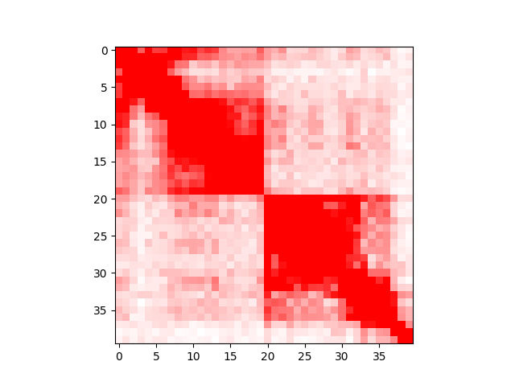
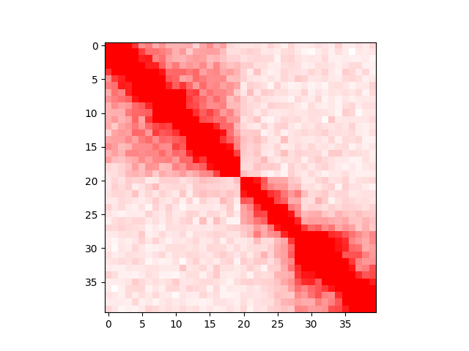
There are other ways one could solve the fusion, but one formulation has an advantage
a b c d
b a c d

Slide 12
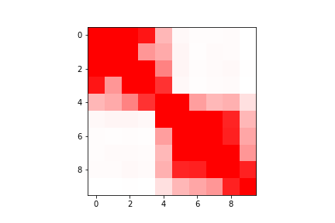
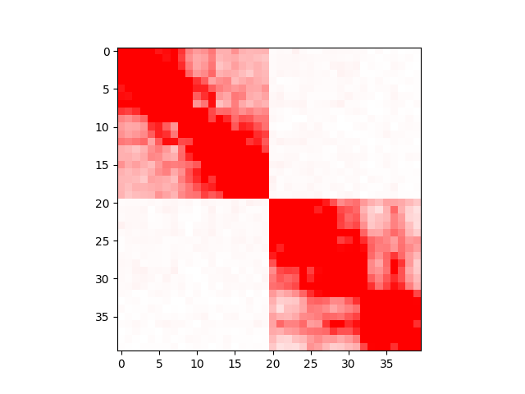
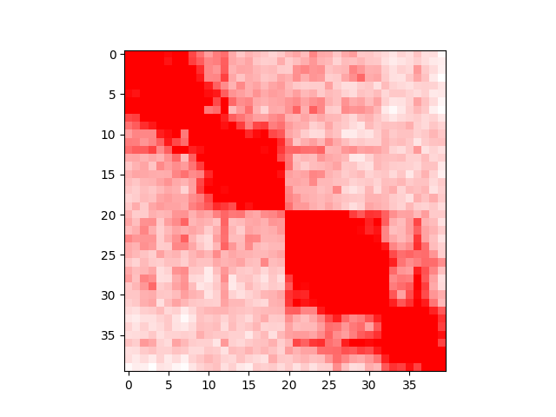
Two birds with one classifier
Fusion = ! Break
Part I: Detect breaks
Part II: Detect fusions that result from those breaks
Since a break is just a lack of a fusion, the same model can detect breaks and fusions.

Slide 13
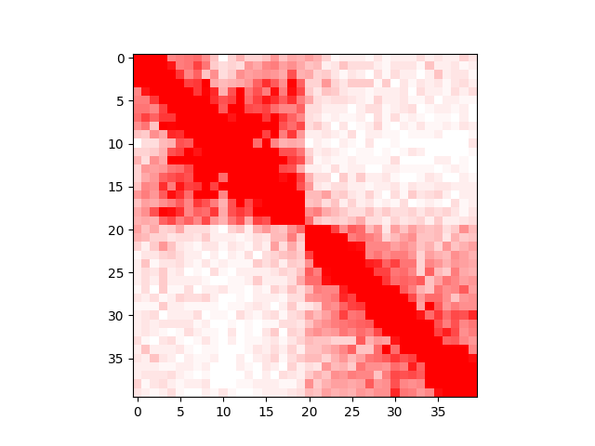
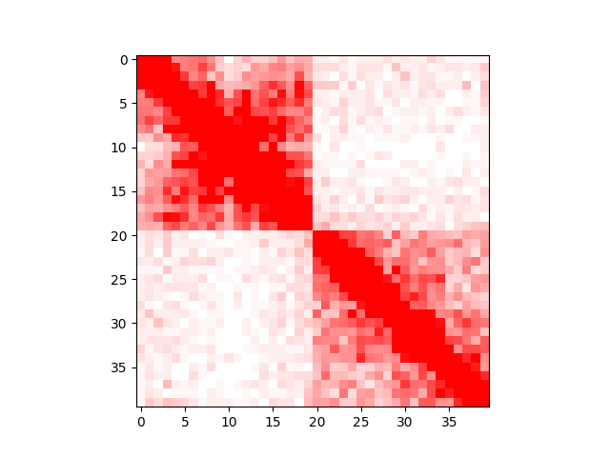
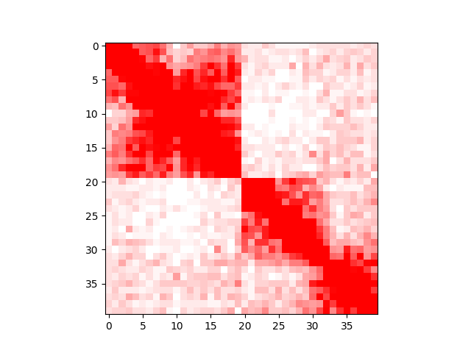

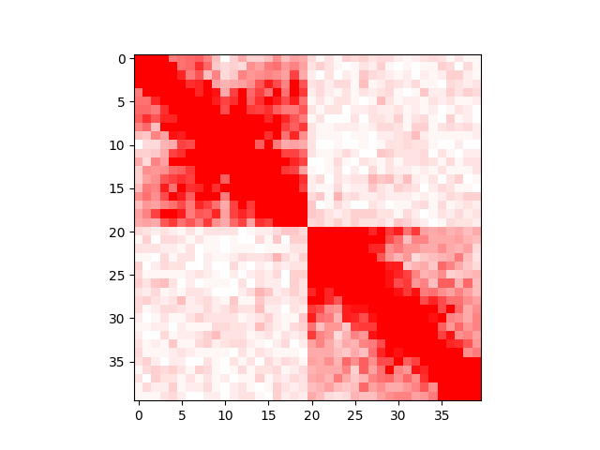
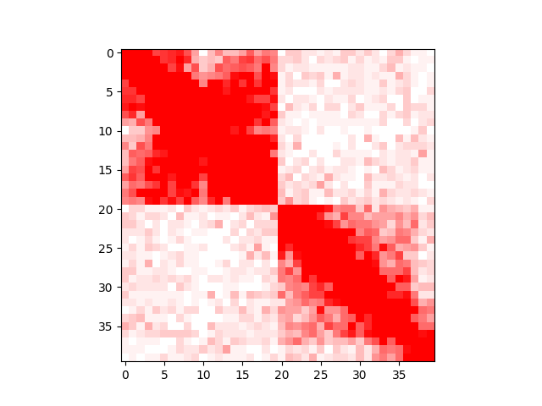
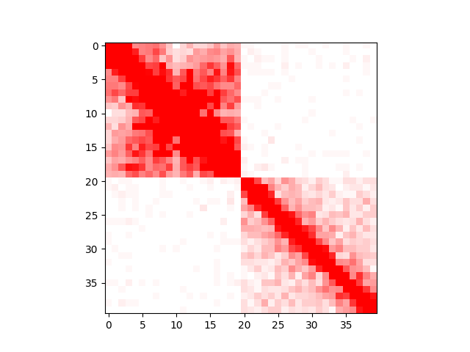
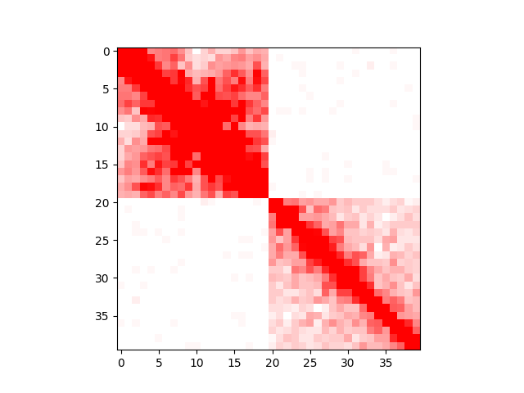
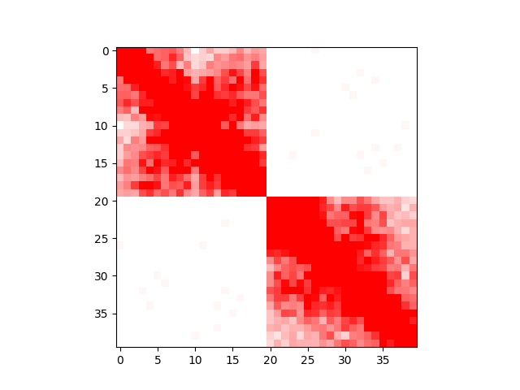
Infinite number of birds with one classifier
0.25 MB
0.5 MB
1 MB
2 MB
5 MB
10 MB
20 MB
100 MB
Interchromosomal

Slide 14
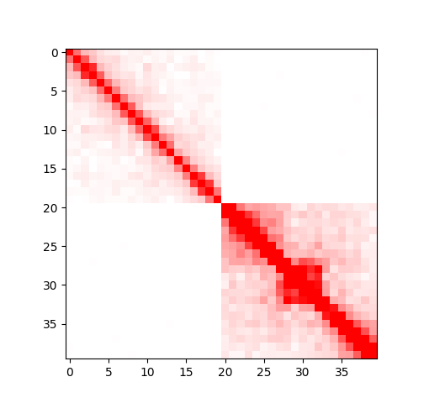


Problem formulation slide
A
B
a₁
a₂
b₁
b₂
For a given contact matrix reflecting interactions within and between two genomic intervals, A and B, the model should estimate the 1D distance between a₂ and b₁.

Slide 15
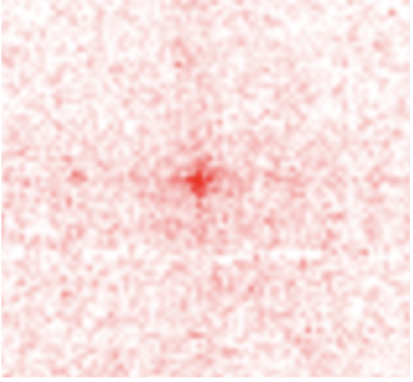
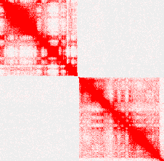
We are not the first ones in the lab to use ML
Notes:
Loops image (is at 5 kb and is 55 by 55) - Done
Break Image (same style as loop image) - Done
Minimize differences in image - Done

Slide 16
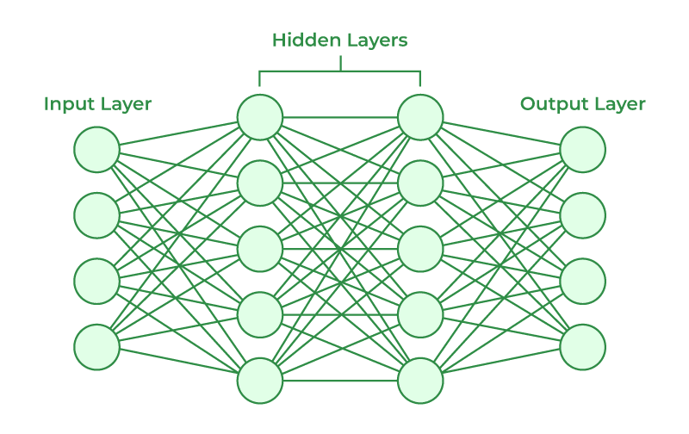
Neural Network
Notes:
TF can output a small visualization of the model - Not working
Keep only relevant functions - Done
Describe the functions that are kept - Done
Add dropout layer image - Done
Remove preprocessing from layers section - Done
Dense layer - hidden layer, turns the input into something the output layer can take in.
Feature generator, detector, and extractor
Generic
The more dense layers, the more complex the function
Slightly more complex than edge detector
Better image more specific to the model - Done

Slide 17
Output Layer
Probability of the distance being within one of nine distance categories.
p₁: Bin 1: 0 to 0.25 MB
p₂: Bin 2: 0.25 to 0.5 MB
p₃: Bin 3: 0.5 to 1 MB
p₄: Bin 4: 1 to 2 MB
p₅: Bin 5: 2 to 5 MB
p₆: Bin 6: 5 to 10 MB
p₇: Bin 7: 10 to 20 MB
p₈: Bin 8: 20+ MB
p₉: Bin 9: Interchromosomal
[0, 0, 0, 0.01, 0.02, 0.03, 0.06, 0.2, 0.68]
Notes:
TF can output a small visualization of the model - Not working
Keep only relevant functions - Done
Describe the functions that are kept - Done
Add dropout layer image - Done
Remove preprocessing from layers section - Done
Dense layer - hidden layer, turns the input into something the output layer can take in.
Feature generator, detector, and extractor
Generic
The more dense layers, the more complex the function
Slightly more complex than edge detector
Better image more specific to the model - Done

Slide 18
Hidden Layers
Convolution
Dropout
Dense
Convolution
Dropout
Dense
Recognizes patterns in images
Prevents Overfitting
Feature generator, detector, and extractor
Notes:
TF can output a small visualization of the model - Not working
Keep only relevant functions - Done
Describe the functions that are kept - Done
Add dropout layer image - Done
Remove preprocessing from layers section - Done
Dense layer - hidden layer, turns the input into something the output layer can take in.
Feature generator, detector, and extractor
Generic
The more dense layers, the more complex the function
Slightly more complex than edge detector
Better image more specific to the model - Done

Slide 19
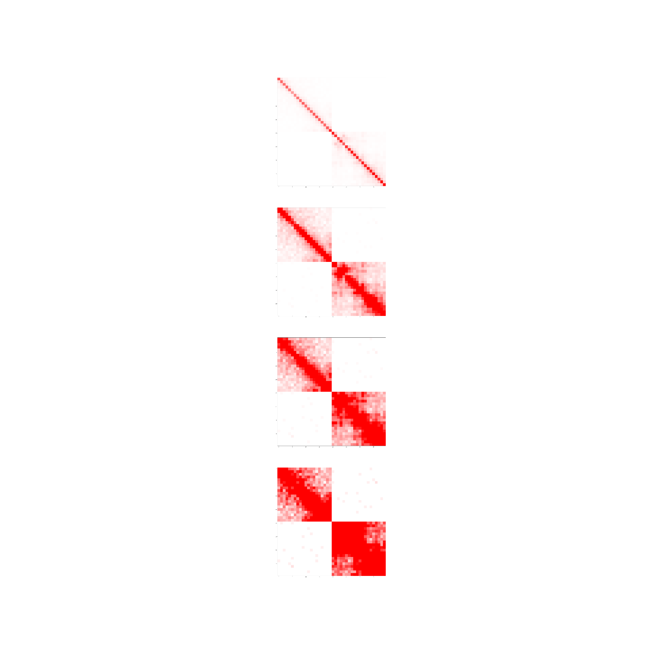
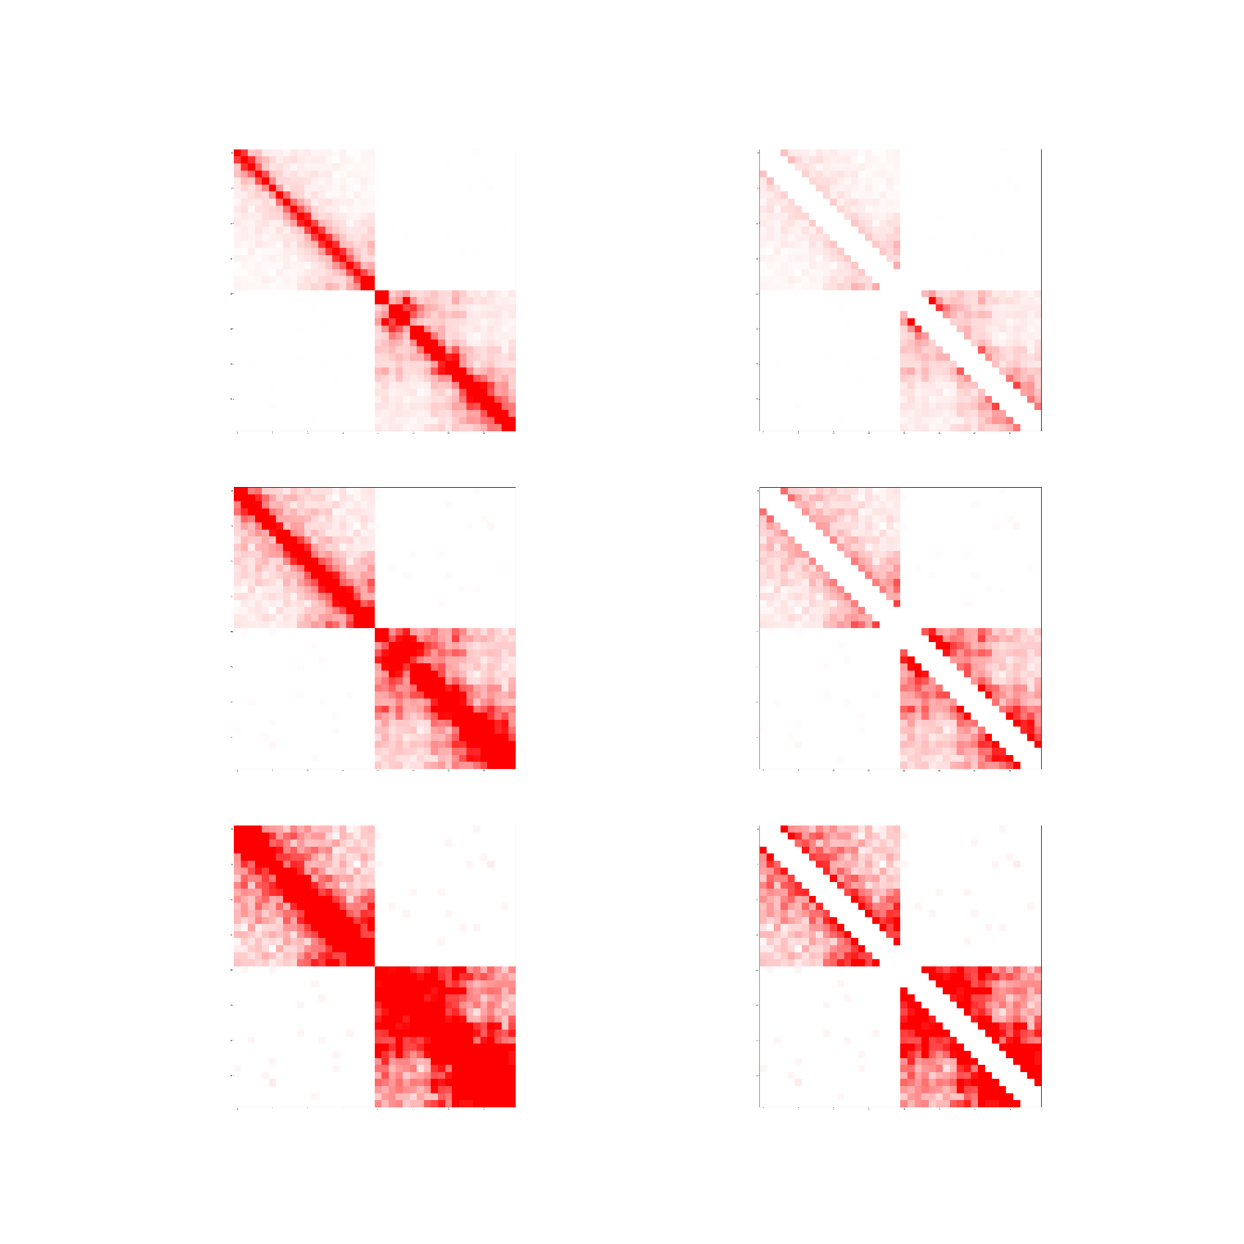
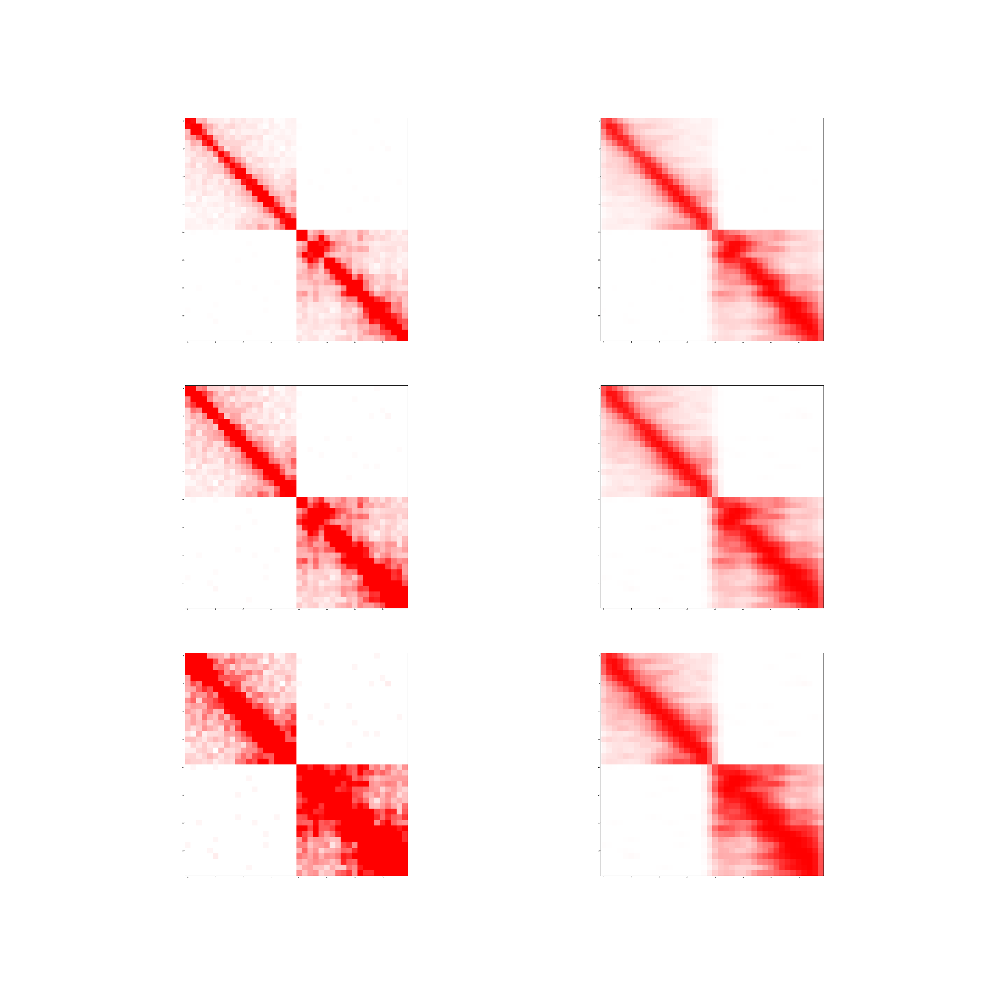
Input Layer
Cap data at the 95th percentile(like in Juicebox), 90th percentile, 80th percentile, then linearly scale it between 0 and 1.
Remove outlier bins
Zero out the first 5 diagonals
Add Gaussian Blur
95%
90%
Original
80%
Capped
0 Diagonals
Gaussian Blur
Notes:
TF can output a small visualization of the model - Not working
Keep only relevant functions - Done
Describe the functions that are kept - Done
Add dropout layer image - Done
Remove preprocessing from layers section - Done
Dense layer - hidden layer, turns the input into something the output layer can take in.
Feature generator, detector, and extractor
Generic
The more dense layers, the more complex the function
Slightly more complex than edge detector
Better image more specific to the model - Done

Slide 20
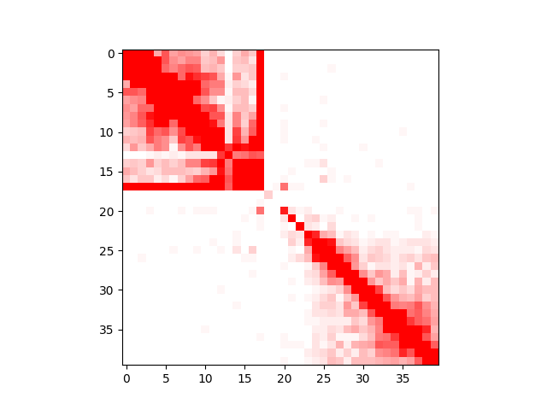
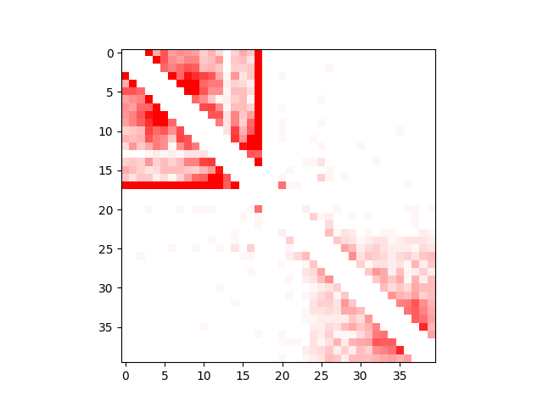
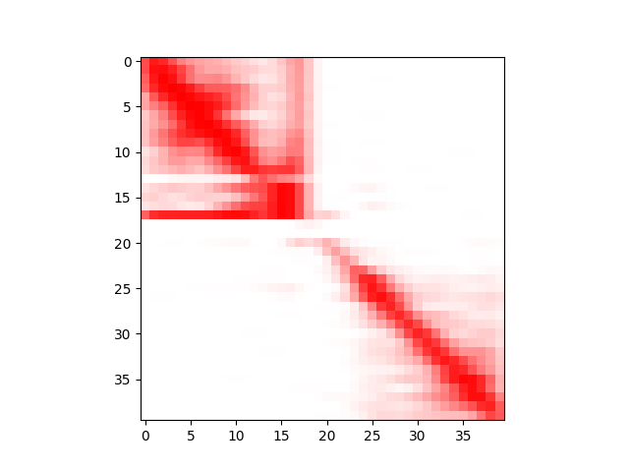
Example

Slide 21
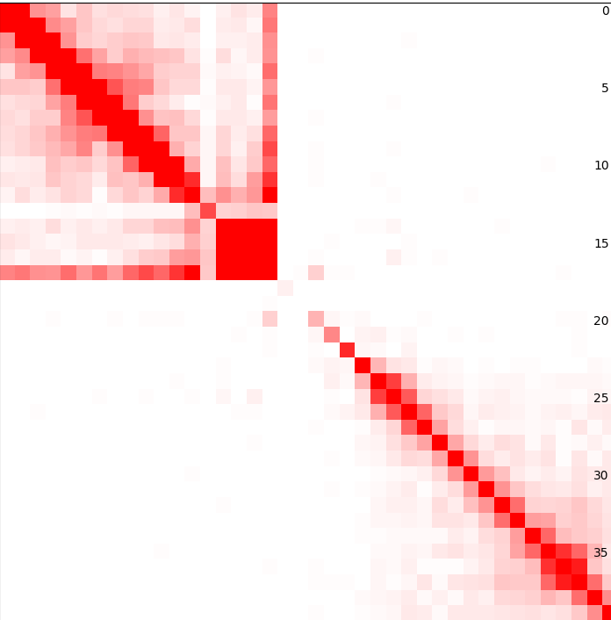
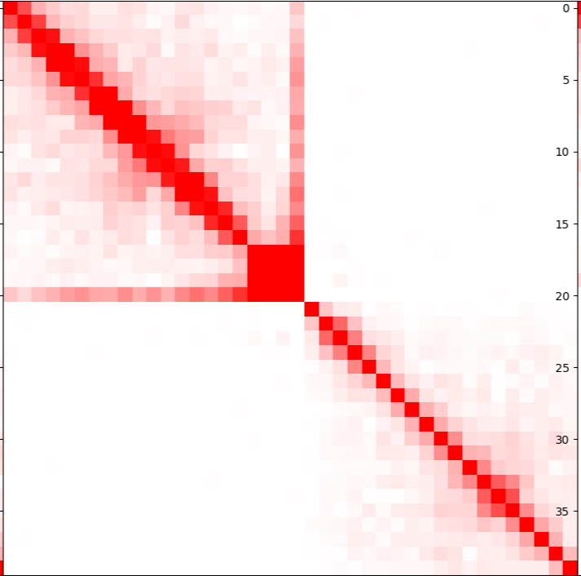
Preprocessing
Remove all bins in the bottom 0.75% of number of contacts
Notes:
Discuss advantages of normalizing manually rather than having the model do it
Merge Normalization visualization with this slide - Done

Slide 22
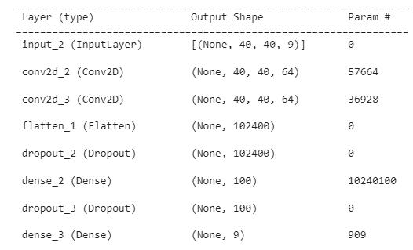
Details of the model - Model Structure

Slide 23
Details: Training & other details
Training Files:
HIC11665_PPM_HiRise_rh_HiC.hic
HIC12835_PPM_HiRise_rh_HiC.hic
Daubentonia_madagascariensis_HiC.hic
Chrysocyon_brachyurus_HiC.hic
Setonix_brachyurus_HiC.hic
primary.hic
Loss function: Categorical Cross Entropy
Resolution: 50 KB
Matrix Size: 40 x 40
Notes:
Add ROC Curve - Done

Slide 24
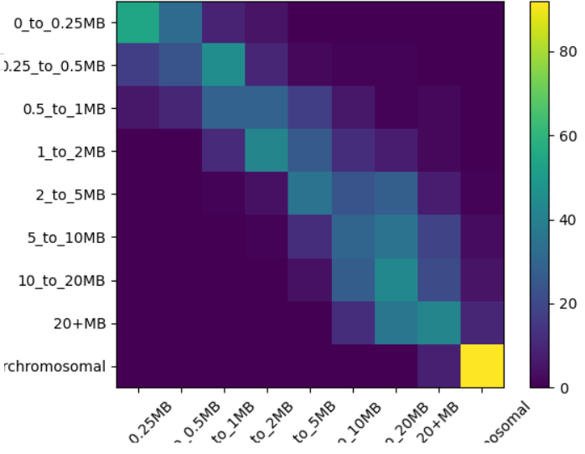
Major result slide #1: confusion matrix
Predicted
Actual

Slide 25
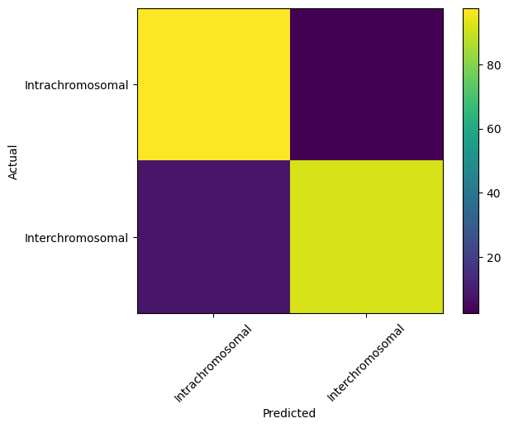
Major result slide #1: confusion matrix
781
19
8
92

Slide 26
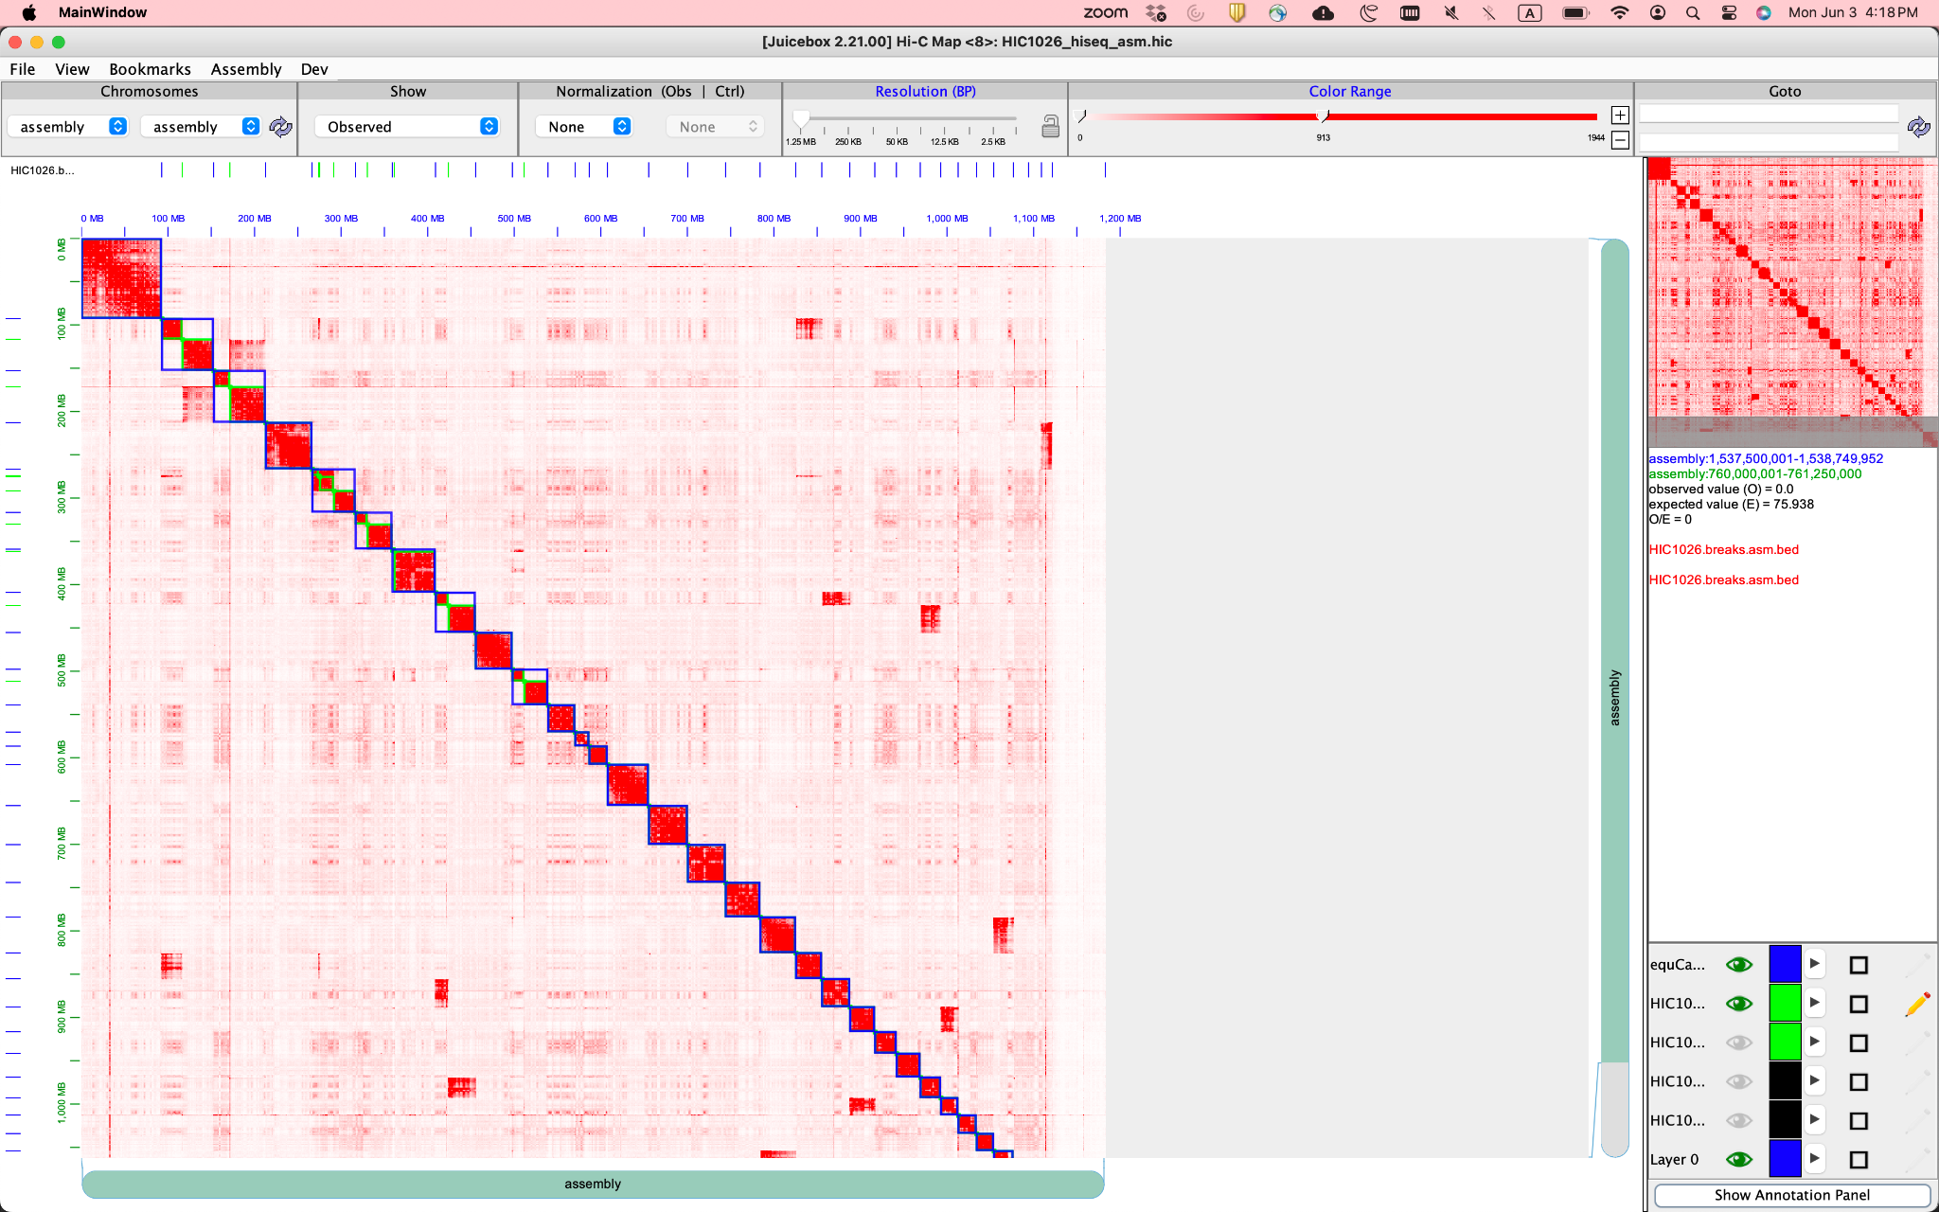
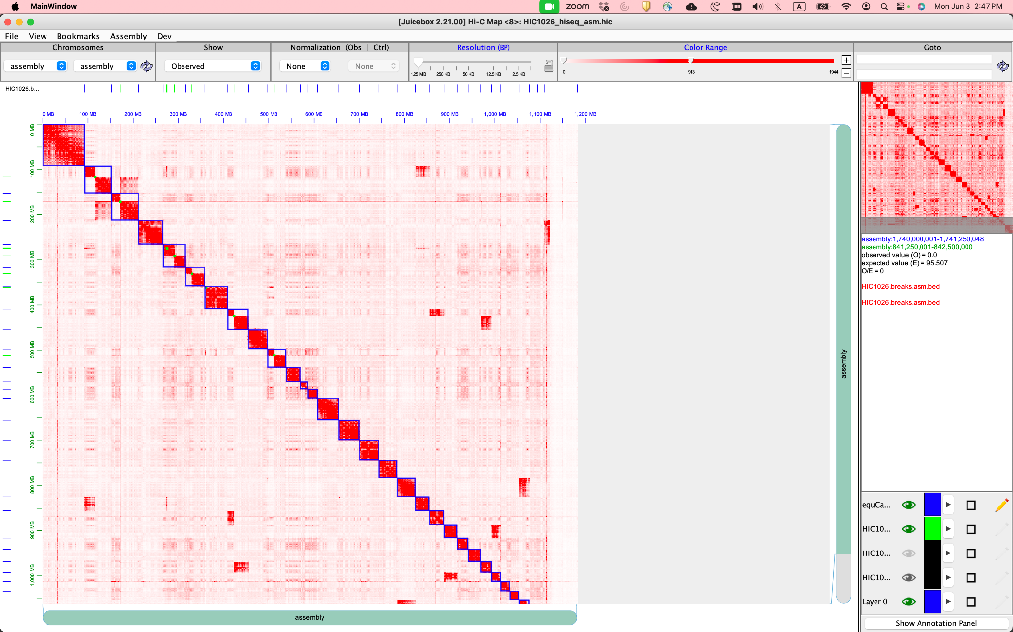
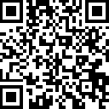
It works very well to identify breaks
https://tinyurl.com/22n4opkm

Slide 27
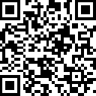
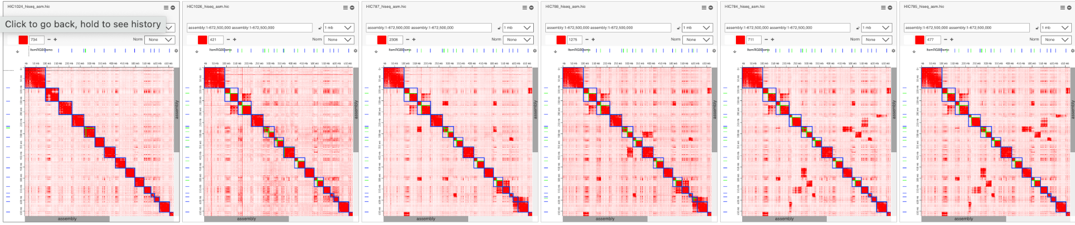
Chromosome breaks in equids
https://tinyurl.com/22zd4jze
1024: 2 true positives, 0 false positives
1026: 7 true positives, 1 false positive
787: 8 true positives, 0 false positives
788: 8 true positives, 1 false positive
784: 9 true positives, 0 false positives
785: 9 true positives, 0 false positives

Slide 28

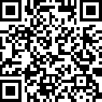
Fusions are harder
https://tinyurl.com/267xtog6

Slide 29
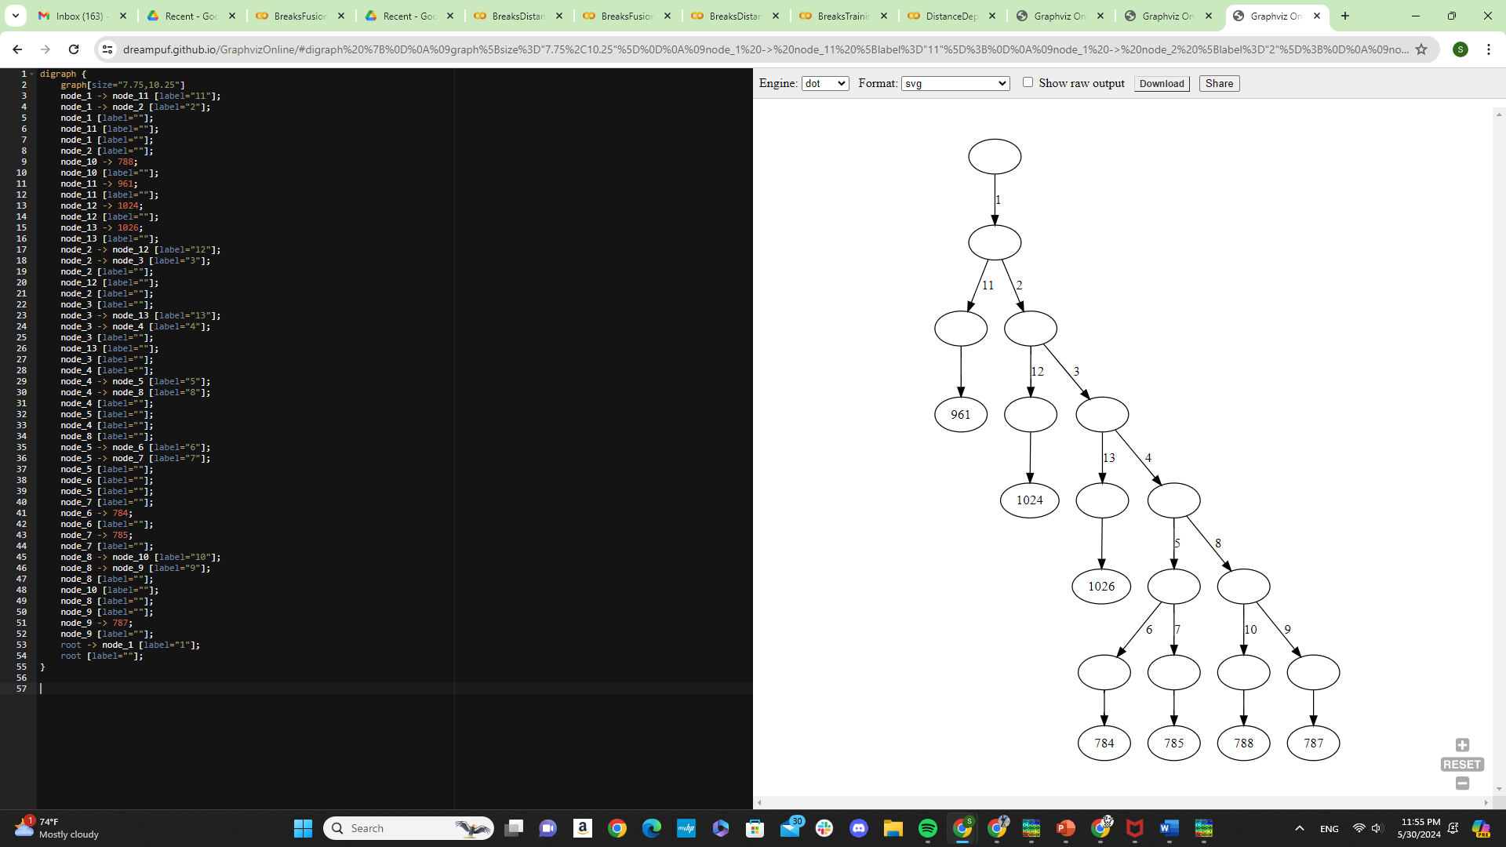
What happens if we try to take it all the way
784/785 - Mountain Zebra Zakota
787 - Grant’s Zebra Zena
788 - Grevy’s Zebra Zoatira
1024 - Horse
1026 - Donkey

Slide 30
Caveats
Limitations: Same species, different input material
784/785 - Mountain Zebra Zakota
787/961 - Grant’s Zebra Zena
788 - Grevy’s Zebra Zoatira
1024 - Horse
1026 - Donkey

Slide 31
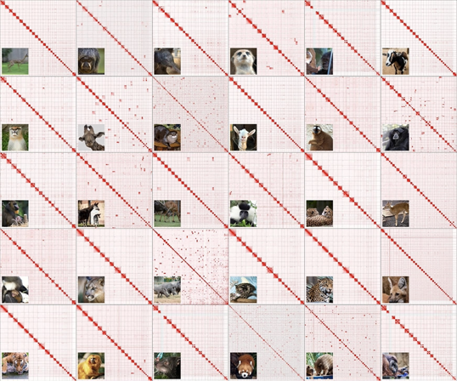
Future plan: pan-mammalian karyotype tree

Slide 32
Acknowledgements
Erez
Olga
Dimos
Aiden lab

